Slide 1

IT CLUB
Presented by :
Sabal Bajagain
INVENTORY MANAGEMENT SYSTEM

Slide 2


List of Contents
1.
2.
The Problem
What It Solved
3.
4.
Uses
Creation Sources
5.
6.
Demonstration
How To Access
7.
Thank You slide

Slide 3


The Problem
There are a lot of management problems that can take place in a business but one of the most important problems to be solved is improper Inventory Management. Without a proper Inventory Management, The sellers will have no idea of the current stock they have.
Example
Why It matters
If a customer arrives to buy an item, the seller may not have the idea of its availability, so when he/she goes to check, they have to check each and every corner and if the product isn’t found, they just wasted the time of their customer! Sometimes, they may find the product after the customer goes away, which can be very frustrating
  Wastes the time of both sellers and customers
  Makes it extremely hard to know about what item is selling the most and what item is selling the least.
  Manual effort for knowing the low in stock items.
  Frequently selling items may run out of stock quickly and can cause loss in demand due to delayed re stock

Slide 4


WHAT IT SOLVED
  Quick and reliable Restocking Alerts
  Low Manual Effort on management
  Easy and Smart Maintenance of Stock availability
  Modern and Advanced Method of management
  Digitalization of Businesses
  Promotion of Business and stores
Revenue growth and investment reduction with digitalization of inventory management!
Smart and Digital management can make a huge difference if implemented even in small and low-developed stores/business by attracting and facilizing customers.

Slide 5

Uses
As a Versatile Service
Smart, Quick and Easy Stock Management
Along with businesses and stores, it can be used it Hotels, Office/Banks and even in homes and personal uses!
Implementing this will give a good idea of what to keep in bulk stock and what to keep in less stock.
Promoting Factor
Finance and sales tracker
Implementing this can help to promote the business as digitalization can catch the eye of any customer and attract them
We can use it to track the revenue, sales and profit of any product in the current stock!

Slide 6
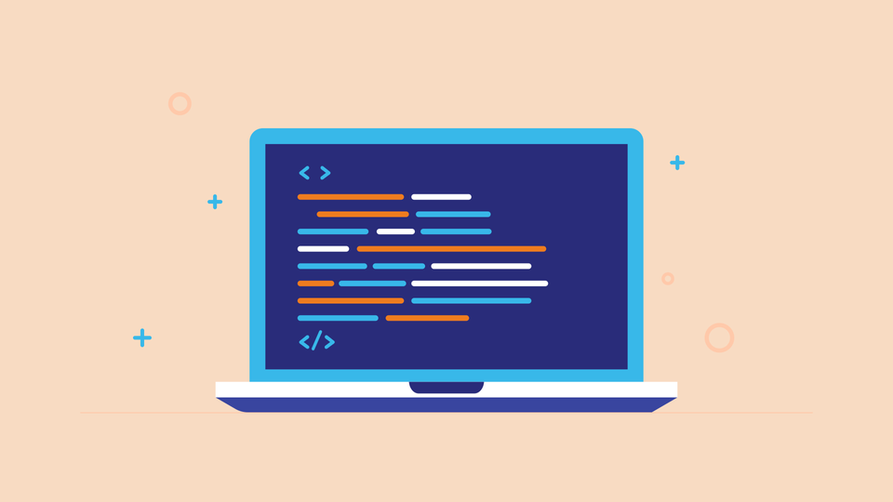




Creation Sources
This is a web service, which was developed by many sources, including Django, AI, PostgreSQL database and Tailwind CSS!
BACKEND
FRONTEND
The backend of this service was developed by using Django as the framework, python as the programming language and PostgreSQL as the database.
Frontend was made by using mainly Tailwind CSS for the design/layout and HTML 5 for the elements of this project!

Slide 7

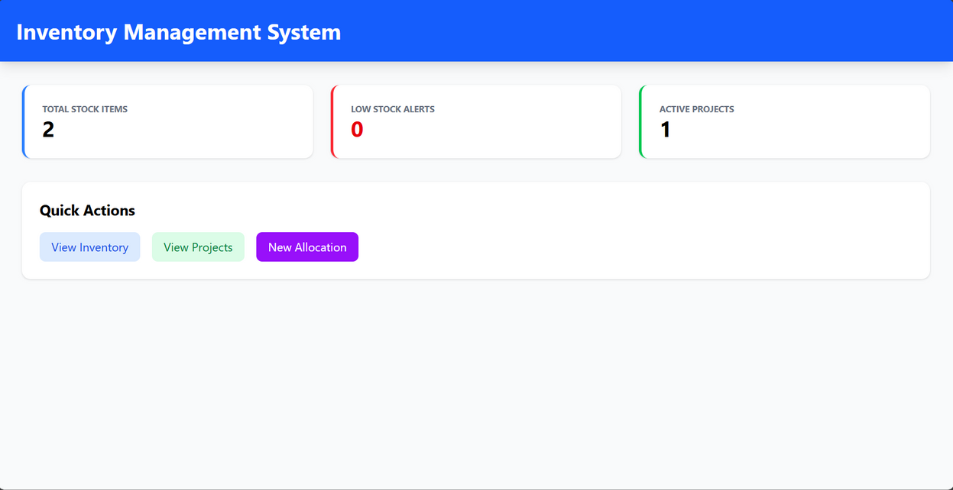
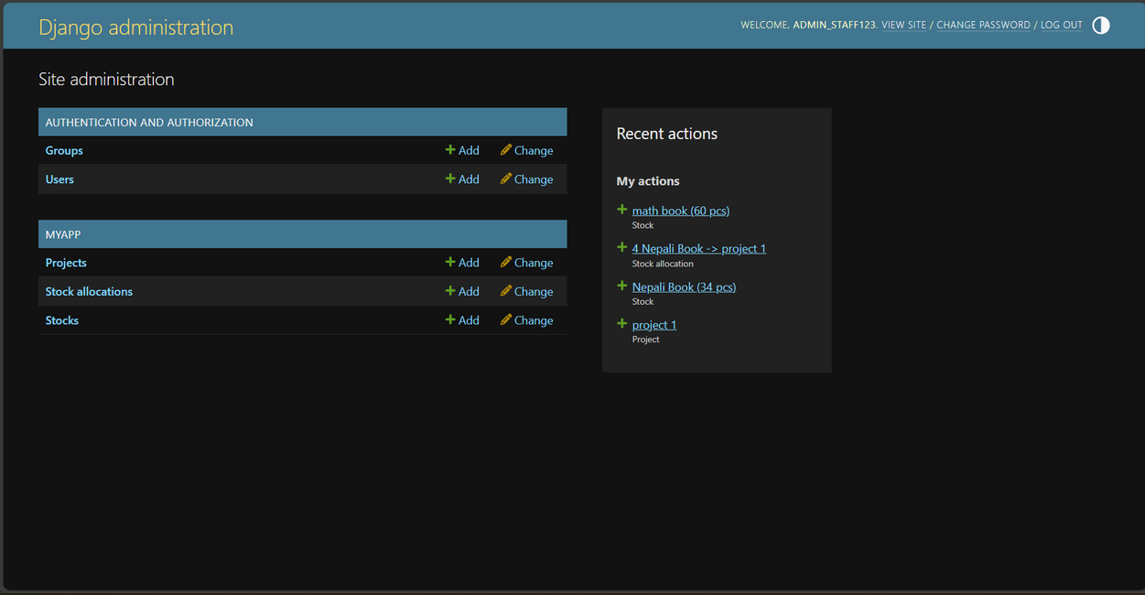
Demonstration
This is the main dashboard page where you can check the stocks, allocate threm and get restock alerts!
This is the admin page where you can add new stocks, projects, users and also know about the history of allocations!

Slide 8

How Can You access?
url for using it right now!
htttps://github.com/sabl62/inventory-management-system/
for the source code!

Slide 9
Thank You
Hope You Liked This Presentation!

